Slide 1
Preventing and managing Conflicts of Interest (COI) i public private partnerships (PPP)
evaluation
WholeGrain Spring School Conference, 29th March 2022
Stela Stojisavljević, MD PhD, on behalf of the PHI RS Project Team
Institute of Public Health of the Republic of Srpska (PHI RS)

Slide 2
PPP in promotion of public health
NCDs (cardiovascular diseases) major factor of morbidity and (cancers) major factor of mortality in the RS
Evidence-based risk factors: unheathy diet, tobacco smoke, alcohol misuse and physical inactivity
PPP arrangements addressing diverse health related issues
UN SDG Goal 17 advocated to countries to establish different partnerships
Limited commercial interest in health promotion
Increased WG intake = reduced unhealty diet = reduced NCDs morbidity and mortality

Slide 3
Republic of Srpska – legal background related to COI
Law on Private-Public Partnership in the Republic of Srpska (Official Gazette of the Republic of Srpska 59/09)
Law on prevention of COI in authorities of the Republic of Srpska (Official Gazette of the Republic of Srpska 73/08)
Law on Civil Servants (Official Gazette of the Republic of Srpska 118/2008, 117/2011, 37/2012 i 57/2016)

Slide 4
Area of Caution for PPP COI?
PI double role: promotion of products from one side and provision of products quality control from another side
Income via productive incentives or public service discounts
Providing industries with false credibility via corporate responsibility
Event sponsorships that are not strictly aimed at the population education on health benefits of WG products

Slide 5
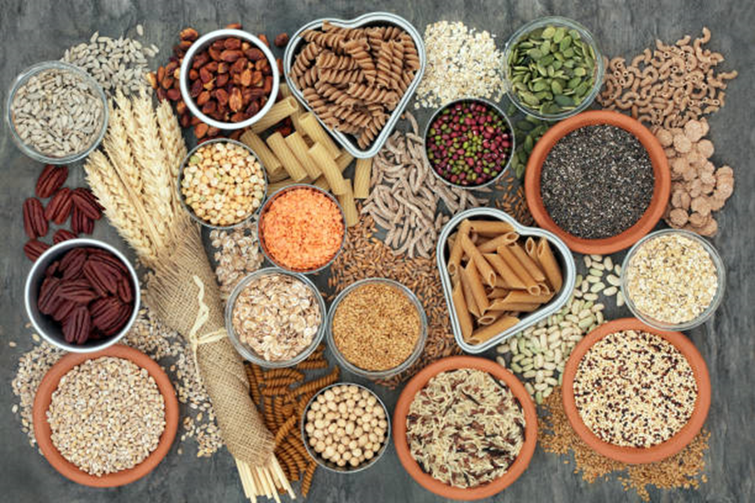
Thanks for your attention!
stela.blk@gmail.com
stela.stojisavljevic@phi.rs.ba
More about the project: https://www.gzs.si/wholeugrain

